Slide 1

FARMERS / TURKU ENERGIA
Finland’s imbalance
price forecast
LSTGBM / 10-hour outlook, updated hourly
37%
lower median price error
66.20 to 41.57 €/MWh vs. the organizer baseline
OFFICIAL VALIDATION
Notes:
FARMERS, Since AI 2026, Turku Energia challenge. The 37% reduction is relative to the organizer’s persistence baseline on the September validation period. Source: evaluation report https://docs.google.com/document/d/159r5Se9YMaapkHR-Go8Vu6tZSOmpEVYJH6pRiGRJgno/edit.
Cover artwork: generated editorial illustration of an electricity network.

Slide 2
THE MODEL MAP
How LSTGBM builds the forecast
02
The imbalance price settles differences between scheduled and actual electricity positions.
Every hour, LSTGBM forecasts the next 40 delivery quarters.
01
02
03
04
Spot anchor
Horizon split
Balancing scenarios
Risk estimates
Start with the published
Use recent grid readings
Weight price scenarios
Combine two estimates
day-ahead price.
for the first two hours.
by the odds of up or down.
of ranges and spikes.
WHAT YOU GET FOR EACH 15-MINUTE INTERVAL
Median price / 80% prediction range / Spike odds / Balancing direction odds
Notes:
The nominal 80% prediction range runs from P10 to P90. Spike odds cover imbalance prices more than €50/MWh above or below the day-ahead spot price. Direction odds cover upward, downward and no dominant balancing.

Slide 3

DECISION 1 / START FROM A KNOWN PRICE
We predict the gap from day-ahead spot
03
A spot price already exists for every delivery quarter.
We forecast how far the imbalance price could move above or below it.
Illustrative prices
Day-ahead spot
Predicted difference
Imbalance price
+
=
€70/MWh
+€40/MWh
€110/MWh
With no dominant balancing direction, settlement is based on spot.
1 Spot anchor
2 Horizon split
3 Balancing scenarios
4 Risk estimates
Notes:
Source: Fingrid’s settlement rules effective 1 June 2026, https://www.fingrid.fi/en/news/news/2026/change-in-determining-the-imbalance-price-for-balance-responsible-parties-in-june-2026/. Forecast method and final spot-curve correction: https://docs.google.com/document/d/159r5Se9YMaapkHR-Go8Vu6tZSOmpEVYJH6pRiGRJgno/edit and https://github.com/kohjiahng/SinceAI/tree/a16ac22ffa497f8d9feaf58ffb54ee557304a50e/pipeline/production.py.
Illustrative arithmetic before the nearby-spot correction. The final model applies a small shift to all three price quantiles based on neighboring published spot prices.
Illustrative arithmetic before the nearby-spot correction. The final model applies a small shift to all three price quantiles based on neighboring published spot prices.

Slide 4

DECISION 2 / NEAR-TERM GRID CONDITIONS CAN PERSIST
We add grid readings for hours 0–2
04
A shortage now can carry into the next few quarters. Farther out, we lean on published forecasts.
ISSUE TIME
2 HOURS
10 HOURS
0–2 h
2–10 h
Near-term LightGBM
Longer-horizon LightGBM
Adds grid imbalance, frequency
Uses published demand, wind and solar
and measured wind
forecasts plus recent market history
Both models use data available when the forecast is issued.
1 Spot anchor
2 Horizon split
3 Balancing scenarios
4 Risk estimates
Notes:
Source: docs/MODEL_CARD.md and final_submission/SOURCES_AND_LICENCES.md. Starter rows enter at or after their first usable origin. Extra feed values enter at least 30 minutes after measurement end. Dataset 397 documents a 20-minute publication delay. The remaining five list a 3-minute update cadence, which does not establish actual publication lag. For test refit, training deliveries precede the 4 Oct 2026 21:00 UTC freeze and their labels are usable by the freeze.
Actual publication lag is unverified for five extra feeds. Feed 397 documents a 20-minute delay. Revision history is unavailable.

Slide 5

DECISION 3 / SHORTAGES AND SURPLUSES MOVE PRICES DIFFERENTLY
Balancing odds weight each price scenario
05
We estimate the price difference from spot under each scenario, then weight it by the odds.
Illustrative example
70%
Shortage
Upward balancing
+€40/MWh
Combine possible prices
using the 70/30 odds
Median difference from spot
30%
Surplus
Downward balancing
This gives the +€40/MWh used in the spot-anchor example.
1 Spot anchor
2 Horizon split
3 Balancing scenarios
4 Risk estimates
Notes:
Illustrative discrete probability masses. The weights are 0.70 and 0.30. The real model estimates conditional spread quantiles with LightGBM, mixes the two CDFs and inverts the result. The fixed 0.2% probability of no dominant direction is included in the exported direction probabilities. Source: final_submission/mixture.py and final_submission/production.py.
In the illustrative example, the combined cumulative probability first reaches 50% in the +€40/MWh spread bin.

Slide 6

DECISION 4 / THE MEDIAN CAN HIDE SPIKES
We blend two estimates of price risk
06
Two quarters can share the same €70/MWh median and have very different risks.
Chance of a price more than €50/MWh above spot
Quarter A
12%
Quarter B
48%
Illustrative probabilities
Two estimates feed the final risk forecast
We average the direct model and the balancing scenarios for spike odds and price ranges.
1 Spot anchor
2 Horizon split
3 Balancing scenarios
4 Risk estimates
Notes:
Illustrative probabilities, not historical forecasts. The final probabilities are the arithmetic mean of the two heads. The low-spike event is a spread strictly below −€50/MWh. The separate P10/P90 forecasts address interval uncertainty. The model widens both sets of tails before blending and shifts price quantiles using the nearby-spot correction. Source: final_submission/production.py.
The high-spike cutoff is above spot + €50/MWh. The low-spike cutoff is below spot − €50/MWh.
For P10 and P90, we widen each model’s interval by 25% before averaging the bounds. In a separate development comparison, widening the direct intervals moved coverage from 69.1% to 80.7%. The direction mixture median also lowered MAE from €42.64 to €41.66/MWh in a separate development comparison.
For P10 and P90, we widen each model’s interval by 25% before averaging the bounds. In a separate development comparison, widening the direct intervals moved coverage from 69.1% to 80.7%. The direction mixture median also lowered MAE from €42.64 to €41.66/MWh in a separate development comparison.

Slide 7
THE RESULTS
Lower losses across the board
07
Official validation, 7 September–4 October 2026. Lower scores are better.
LSTGBM
Turku Energia baseline
Reduction
Median price error
41.57
37%
MAE (€/MWh)
66.20
Price range accuracy
11.77
51%
Mean P10/P90 pinball loss
24.18
Spike probability accuracy
0.09050
20%
Mean Brier loss
0.11318
Balancing direction accuracy
0.39297
13%
Brier loss
0.45091
Actual prices inside the range
68.3% to 81.3%
80% target
Notes:
Source: FARMERS Turku Energia Evaluation Report, §5, and the organizer’s scorer. Official retrospective validation, 26,700 scored rows per metric. The Turku Energia baseline carries forward the latest available imbalance price for the median, adds historical error quantiles for the range, and uses historical frequencies for spike and balancing odds. Bars are scaled to the baseline within each metric. The held-out test is scored separately.

Slide 8
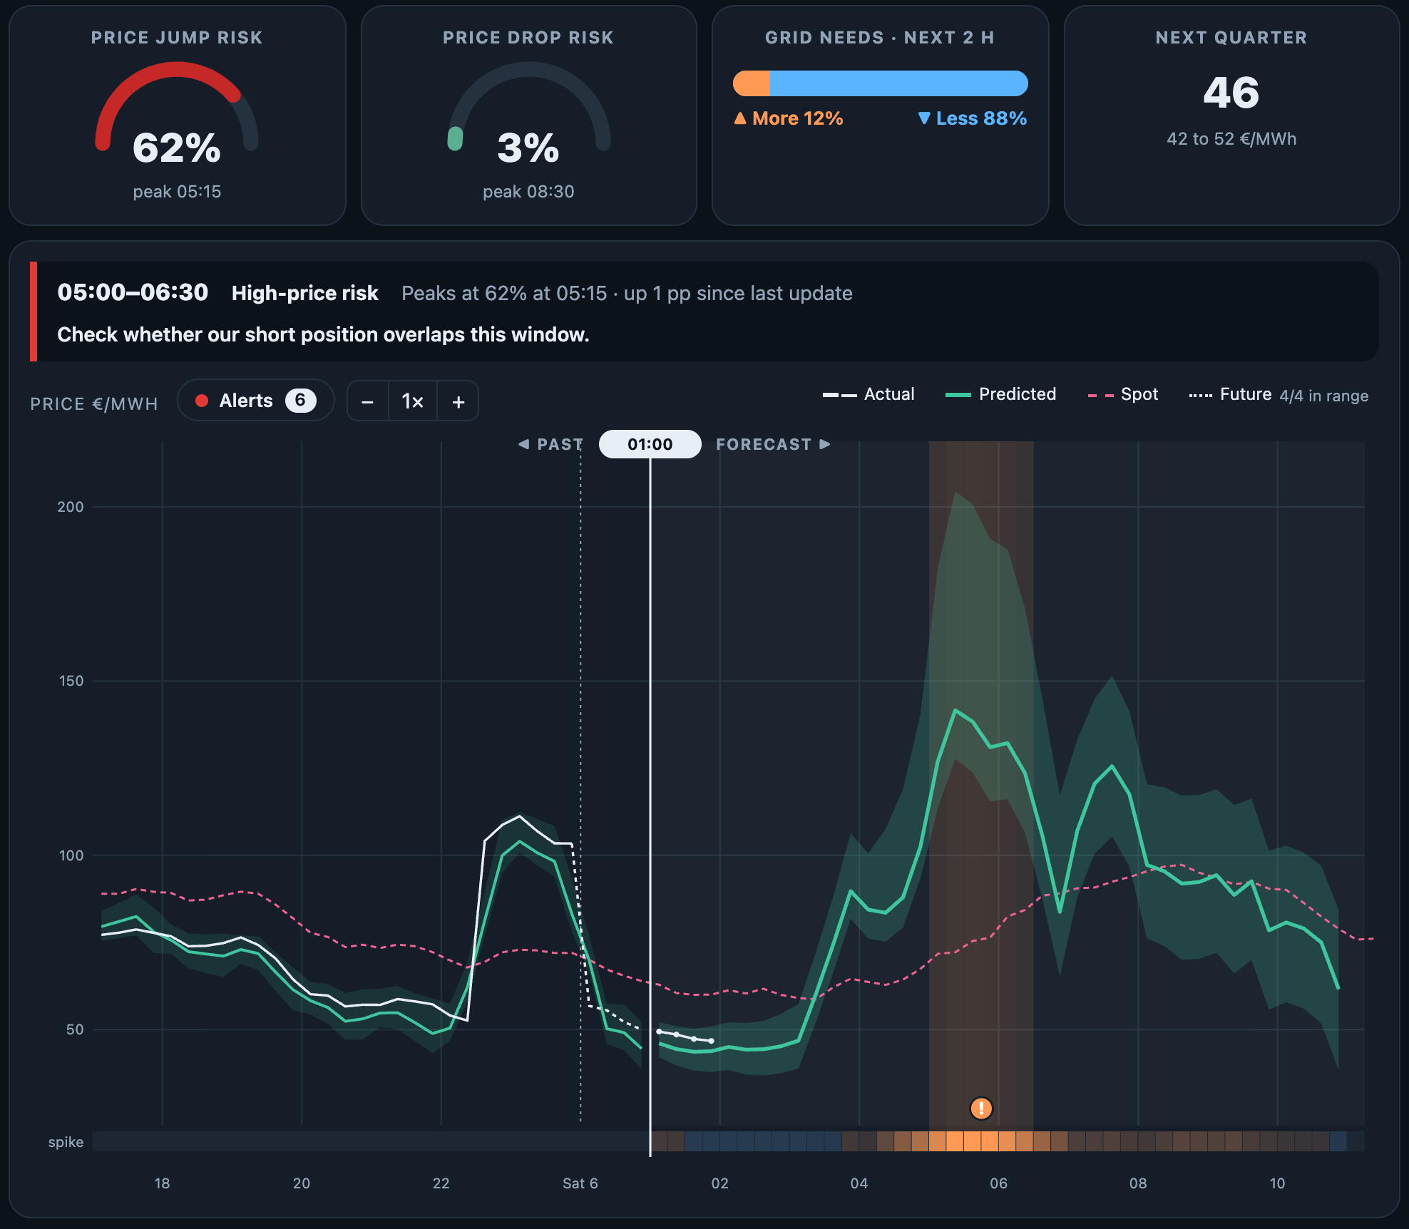
LEVEL 2 / SITUATIONAL OVERVIEW / SIMULATED REPLAY
Radar flags when to review a position
08
01 LOOK AHEAD
See the next 10 hours of prices,
uncertainty and balancing needs.
02 CHECK EXPOSURE
62% spike risk
Radar flags 05:00–06:30 and suggests
checking whether a short position overlaps.
03 REVIEW IN HINDSIGHT
Rewind to an earlier forecast, reveal actual
prices and compare them with the range.
Explore also shows forecast performance by day or run.
Notes:
Radar dashboard, main commit aa6570d426ba6861e4cbc3204095c84fb07397bb. The screenshot shows the simulated Live demo replayed one hour back. In this example, high-price risk peaks at 62% at 05:15, up one percentage point since the previous update. Four revealed quarters fall within the prediction range. The Alerts drawer lists key forecast factors and other alerts. On the Explore tab, Metrics compares forecasts with actuals for a selected day or the whole run. The dashboard uses JSON endpoints for forecasts, alerts, replay tracks and metrics. Source: Turku Energia / Since AI 2026 challenge brief, Level 2 criteria and demo guidance (pp. 3 and 7–8).

